Slide 1

4 variables; Adders
Computer Organization and Architecture | Introduction to Digital Fundamentals
Course: Computer Organization and Architecture | Chapter: Introduction to Digital Fundamentals | Program: Bachelor of Engineering
DISCOVER · LEARN · EMPOWER
Notes:
Welcome everyone to today's lecture on Digital Fundamentals. We will focus specifically on the logic behind adders and how four variables interact in digital circuits. Remember, mastering these basics is the first step toward designing complex processors. Let us begin our journey into the heart of computer architecture.

Slide 2
Course Outcomes
SLIDE 2 / 14
Course Outcome
CO | BT LEVEL | DESCRIPTION
CO1 | BT3 | Apply number systems and digital logic to design basic digital circuits
CO2 | BT4 | Analyze register organization and instruction set architecture
CO3 | BT3 | Implement computer arithmetic algorithms and floating-point operations
CO4 | BT5 | Analyze memory hierarchy and input-output organization
CO5 | BT6 | Evaluate control unit design and pipelining performance
Chandigarh University
2 / 14
Notes:
Today's lecture directly addresses Course Outcome 1. You will learn to apply digital logic principles to design basic circuits like adders. This outcome ensures you can translate theoretical number systems into practical hardware designs. By the end of this session, you will be able to construct these circuits yourself.

Slide 3
Learning Objectives
SLIDE 3 / 14
Learning Outcomes
1
Analyze the role of four variables in determining adder complexity
2
Construct truth tables for multi-bit addition operations
3
Differentiate between half-adders and full-adder logic structures
4
Evaluate the propagation delay in cascaded adder configurations
5
Design a 4-bit ripple carry adder using basic gates
Chandigarh University
3 / 14
Notes:
By the end of this class, you will be able to analyze how four variables affect circuit complexity. You will construct truth tables to verify the logic of multi-bit addition. We will differentiate between half and full adders to understand their specific roles. Finally, you will evaluate propagation delays and design a complete 4-bit ripple carry adder.

Slide 4
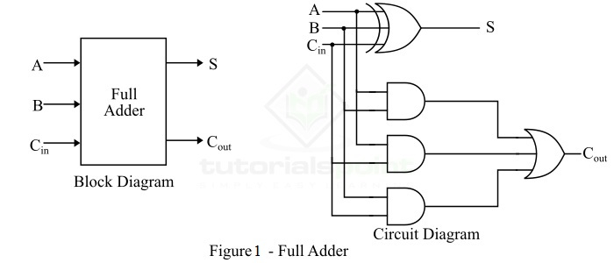
Lecture
SLIDE 4 / 14
Defining the Four Variables
1
The four variables are two inputs (A, B), a carry-in (C_in), and a sum output (S)
2
A and B represent the bits being added at the current position
3
C_in represents the carry generated from the previous less significant bit
4
S is the resulting sum bit for the current position
5
These variables define the state of a single full-adder stage
6
The output carry (C_out) is a derived variable from these four
7
Understanding these variables is essential for cascading adders into larger units
Full Adder in Digital Electronics
Chandigarh University
4 / 14
Notes:
Let us define the four critical variables in a full adder. Inputs A and B are the bits we are adding, while C_in is the carry from the previous stage. The sum output S is the result of this addition. These four variables define the state of a single stage. Without understanding these, we cannot build larger arithmetic units.

Slide 5
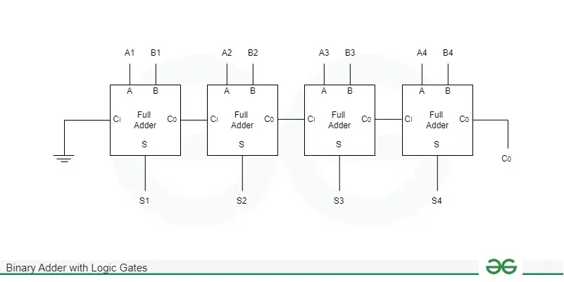
Lecture
SLIDE 5 / 14
Truth Table for Full Adder
1
The truth table lists all 8 possible combinations of the four variables
2
Rows 0-3 show cases where the carry-in is zero
3
Rows 4-7 show cases where the carry-in is one
4
Sum (S) is 1 when an odd number of inputs are 1
5
Carry-out (C_out) is 1 when two or more inputs are 1
6
This table forms the basis for deriving Boolean expressions
7
It validates the logic before any physical circuit is built
Binary Adder with Logic Gates - GeeksforGeeks (source: media.geeksforgeeks.org)
Chandigarh University
5 / 14
Notes:
The truth table lists all eight combinations of our four variables. Rows zero through three handle cases where the carry-in is zero. Rows four through seven handle cases where the carry-in is one. The sum is one when an odd number of inputs are active. The carry-out is one when two or more inputs are active.

Slide 6
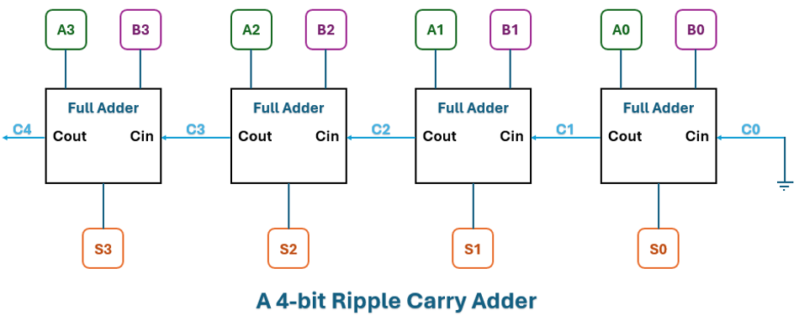
Lecture
SLIDE 6 / 14
Boolean Expressions for S and C_out
GOVERNING EQUATION
Sum S = A ⊕ B ⊕ C_in (XOR of all three inputs)
1
Carry-out C_out = (A · B) + (C_in · (A ⊕ B))
2
The XOR operation detects odd parity for the sum bit
3
The AND-OR logic detects majority voting for the carry bit
4
These expressions minimize the number of gates required
5
Simplification reduces power consumption and physical chip area
6
Correct derivation ensures the circuit functions for all input states
Comprehensive Guide to 4-bit Adders: Theory, Implementation and Modern Innovations (source: images.wevolver.com)
Chandigarh University
6 / 14
Notes:
The sum is the XOR of all three inputs, detecting odd parity. The carry-out uses AND-OR logic to detect when two or more inputs are active. These expressions minimize the number of gates required for the circuit. Simplification reduces power consumption and physical chip area. Correct derivation ensures the circuit functions for all input states.

Slide 7
Lecture
SLIDE 7 / 14
Half Adder vs Full Adder
1
A half adder adds two bits but lacks a carry-in input
2
A full adder adds two bits plus a carry-in from a lower stage
3
Half adders cannot be cascaded to form multi-bit adders
4
Full adders are the building blocks for all multi-bit arithmetic
5
A full adder can be constructed using two half adders
6
The carry-out of the first half adder feeds the second
7
This modular design simplifies the overall circuit architecture
Binary Adder with Logic Gates - GeeksforGeeks (source: media.geeksforgeeks.org)
Chandigarh University
7 / 14
Notes:
A half adder adds two bits but lacks a carry-in input. A full adder adds two bits plus a carry-in from a lower stage. Half adders cannot be cascaded to form multi-bit adders. Full adders are the building blocks for all multi-bit arithmetic. A full adder can be constructed using two half adders in a modular design.

Slide 8
Lecture
SLIDE 8 / 14
Cascading Adders for Multi-Bit Addition
1
Connect the carry-out of one stage to the carry-in of the next
2
This creates a Ripple Carry Adder structure for N-bit numbers
3
The least significant bit uses a half adder or full adder
4
All subsequent bits use full adders to handle incoming carries
5
The final carry-out represents the overflow of the addition
6
This method allows adding numbers of any bit width
7
The chain length determines the total propagation delay
Comprehensive Guide to 4-bit Adders: Theory, Implementation and Modern Innovations (source: images.wevolver.com)
Chandigarh University
8 / 14
Notes:
Connect the carry-out of one stage to the carry-in of the next. This creates a Ripple Carry Adder structure for N-bit numbers. The least significant bit uses a half adder or full adder. All subsequent bits use full adders to handle incoming carries. The final carry-out represents the overflow of the addition.

Slide 9
Worked Example
SLIDE 9 / 14
4-bit Addition
GOVERNING EQUATION
Bit 0: 1 + 0 = 1, Sum=1, Carry=0
RESULT
10001 (17 in decimal)
• Add binary 1011 (11) and 0110 (6) using a 4-bit adder
• Bit 1: 1 + 1 + 0 = 2, Sum=0, Carry=1
• Bit 2: 0 + 1 + 1 = 2, Sum=0, Carry=1
• Bit 3: 1 + 0 + 1 = 2, Sum=0, Carry=1
• The final carry-out indicates the result exceeds 4 bits
Comprehensive Guide to 4-bit Adders: Theory, Implementation and Modern Innovations (source: images.wevolver.com)
Chandigarh University
9 / 14
Notes:
Let us add binary 1011 and 0110 using a 4-bit adder. Bit zero gives a sum of one with no carry. Bit one gives a sum of zero with a carry of one. Bit two also gives a sum of zero with a carry of one. Bit three gives a sum of zero with a final carry of one. The result is 10001, which is 17 in decimal.

Slide 10
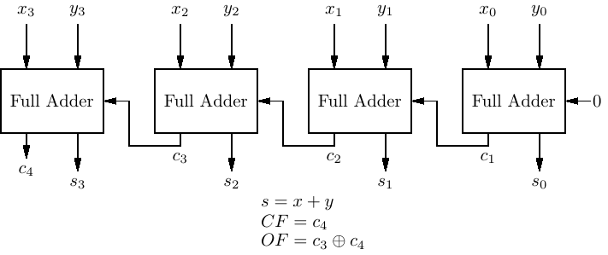
Lecture
SLIDE 10 / 14
Propagation Delay Analysis
1
Each full adder introduces a delay for the carry signal to pass
2
The total delay is proportional to the number of bits added
3
A 4-bit adder has four × the delay of a single stage
4
This delay limits the maximum clock speed of the processor
5
Carry-lookahead adders reduce this delay by calculating carries in parallel
6
Understanding delay is crucial for high-speed digital design
7
Slower adders cause bottlenecks in arithmetic logic units
5 Logic Circuits (source: bob.cs.sonoma.edu)
Chandigarh University
10 / 14
Notes:
Each full adder introduces a delay for the carry signal to pass. The total delay is proportional to the number of bits added. A 4-bit adder has four × the delay of a single stage. This delay limits the maximum clock speed of the processor. Understanding delay is crucial for high-speed digital design.

Slide 11
Lecture
SLIDE 11 / 14
Common Pitfalls in Design
1
Forgetting to connect the carry-out to the next carry-in
2
Using a half adder for intermediate bits instead of a full adder
3
Ignoring the initial carry-in for the least significant bit
4
Misinterpreting the final carry-out as a sum bit
5
Assuming zero delay in high-speed simulation environments
6
Incorrect wiring of XOR gates for the sum output
7
Overlooking the need for a carry-lookahead in large N-bit systems
Chandigarh University
11 / 14
Notes:
Common pitfalls include forgetting to connect the carry-out to the next carry-in. Using a half adder for intermediate bits instead of a full adder is a frequent error. Ignoring the initial carry-in for the least significant bit can lead to wrong results. Misinterpreting the final carry-out as a sum bit is another common mistake.

Slide 12
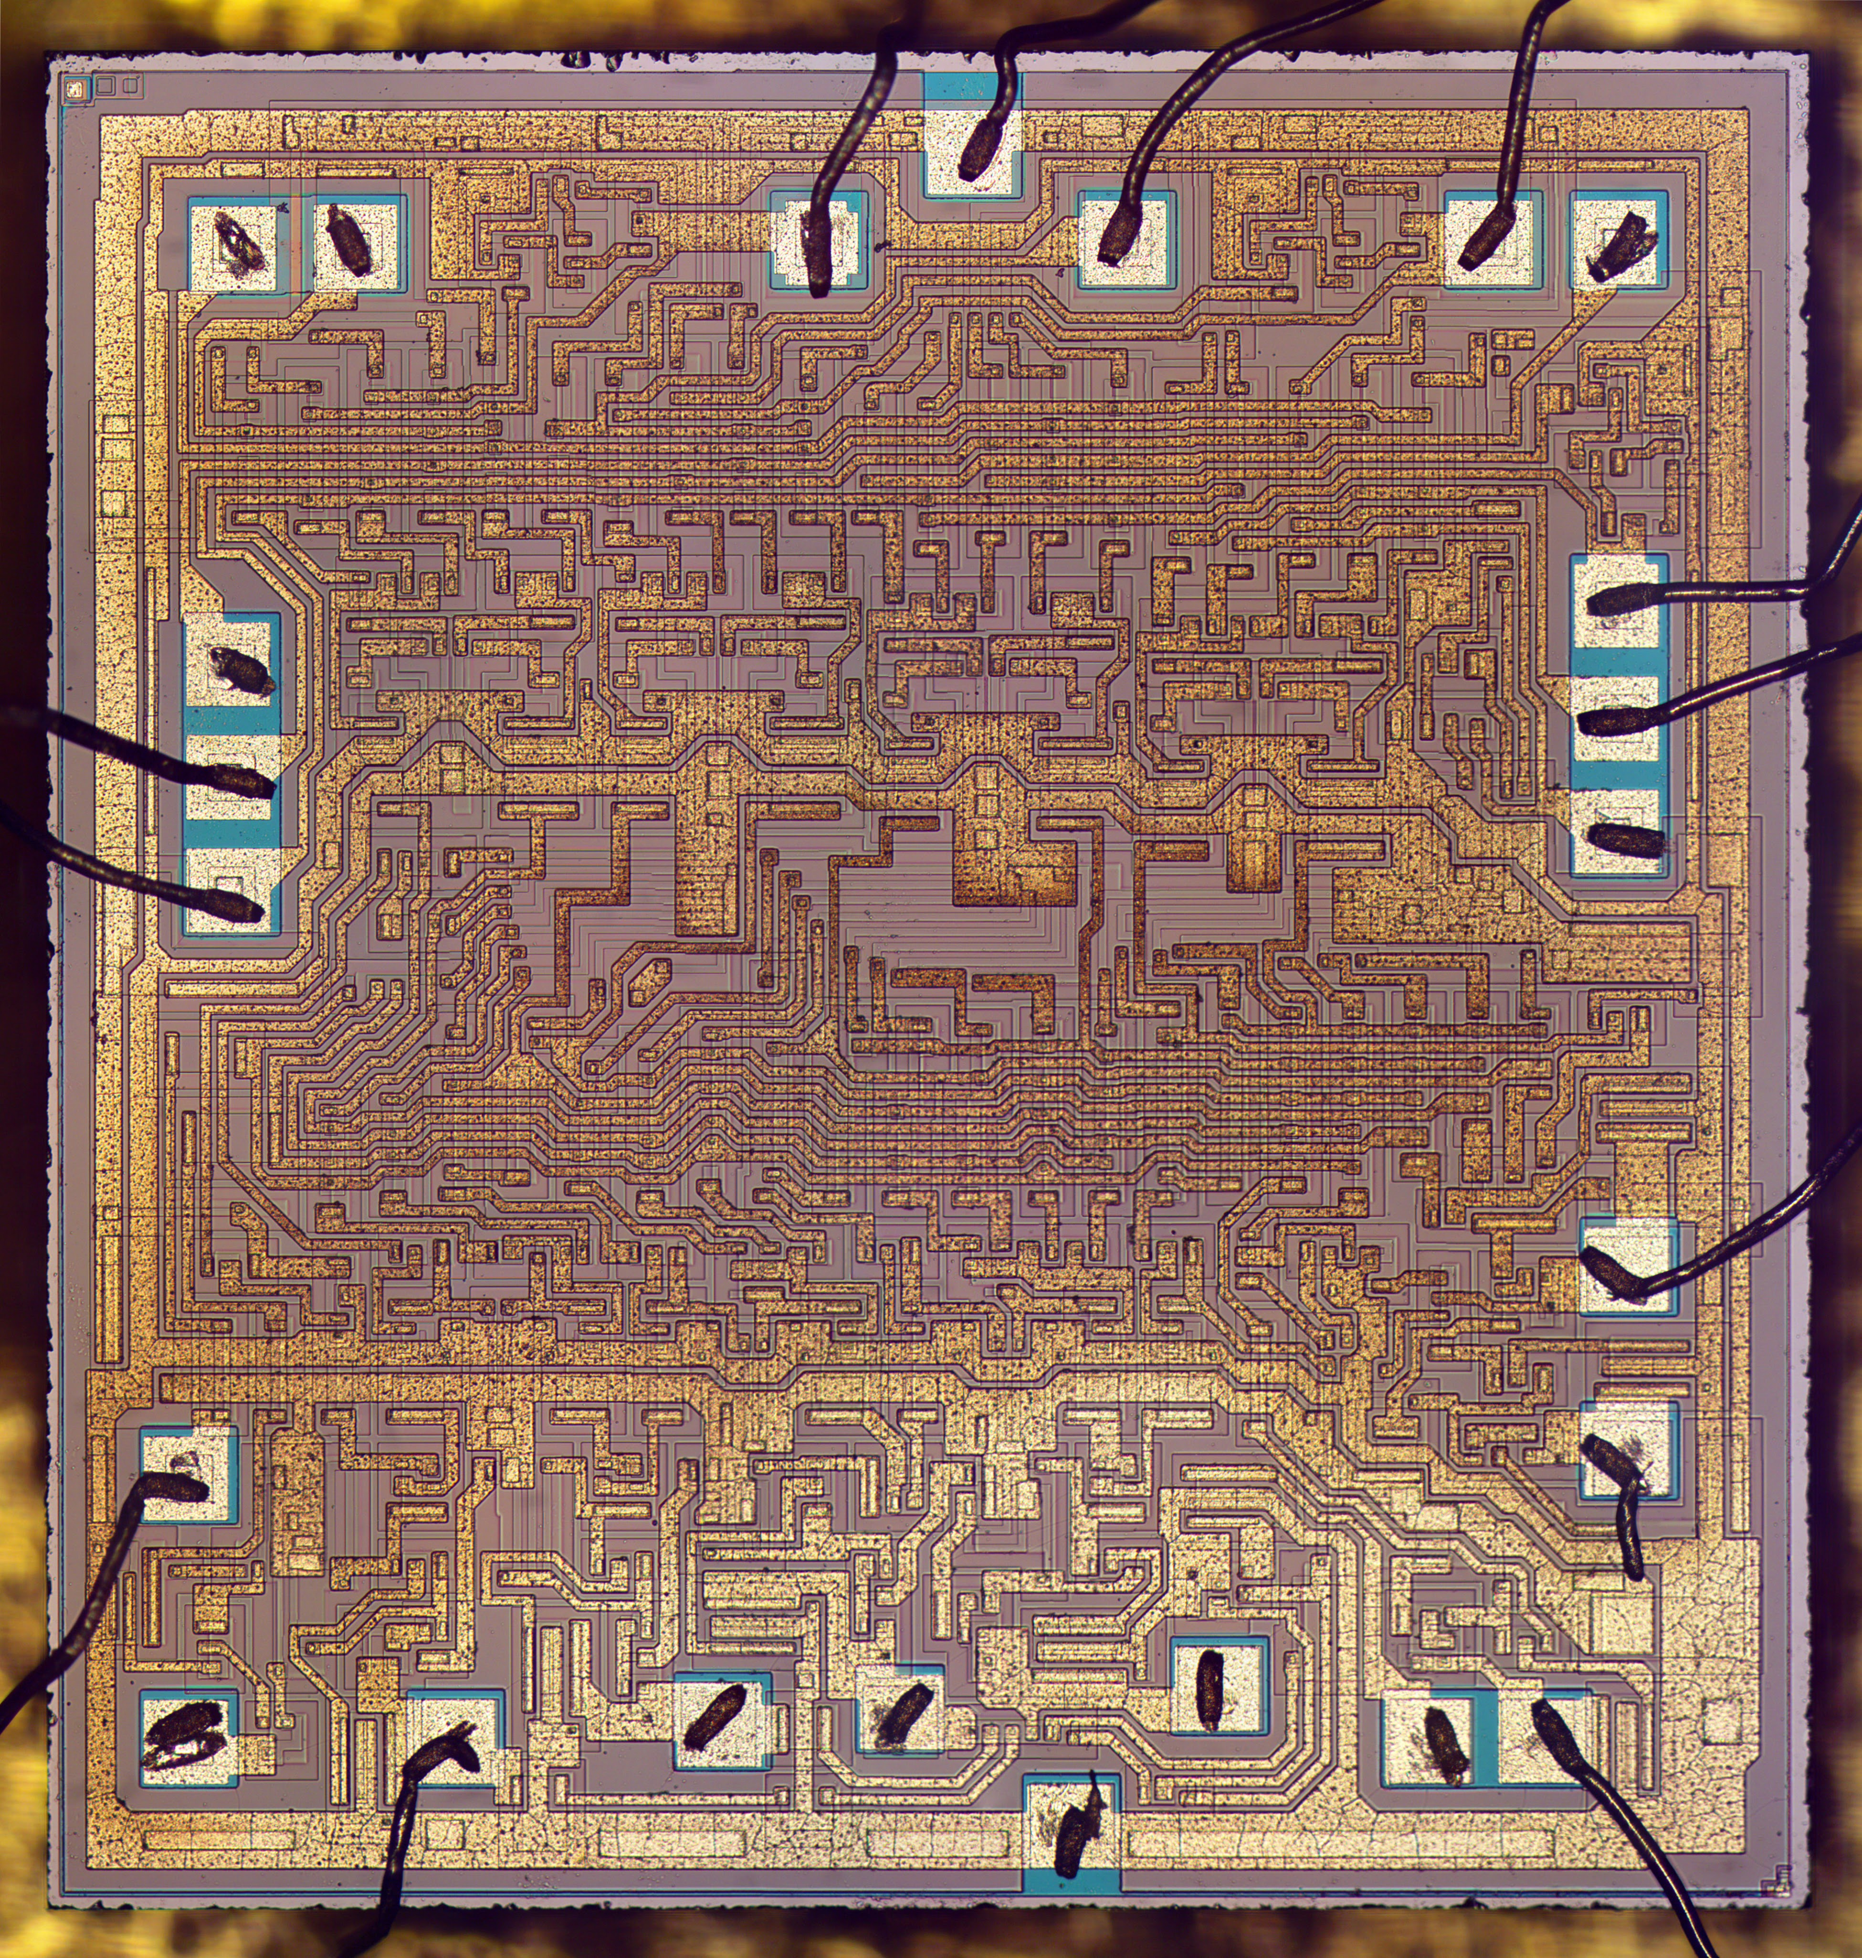
Lecture
SLIDE 12 / 14
Why This Matters for CO1
1
Designing adders directly applies digital logic to circuit creation
2
Understanding variables ensures correct implementation of arithmetic units
3
This knowledge is foundational for ALU design in processors
4
Errors in adder logic lead to catastrophic system failures
5
Mastery of these concepts enables efficient hardware optimization
6
You are now equipped to design basic digital circuits as per CO1
7
This bridges the gap between theory and practical engineering
Source: blogger.googleusercontent.com
Chandigarh University
12 / 14
Notes:
Designing adders directly applies digital logic to circuit creation. Understanding variables ensures correct implementation of arithmetic units. This knowledge is foundational for ALU design in processors. Errors in adder logic lead to catastrophic system failures. You are now equipped to design basic digital circuits as per CO1.

Slide 13
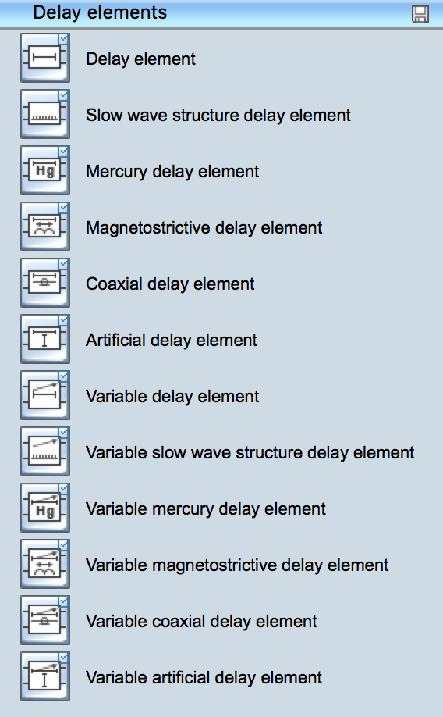
Lecture
SLIDE 13 / 14
Key Takeaways
1
Four variables (A, B, C_in, S) define the full adder operation
2
Full adders are cascaded to create multi-bit ripple carry adders
3
Sum is the XOR of inputs; Carry is the majority function
4
Propagation delay increases linearly with the number of bits
5
Correct wiring and component selection are critical for functionality
Source: www.conceptdraw.com
Chandigarh University
13 / 14
Notes:
Four variables define the full adder operation. Full adders are cascaded to create multi-bit ripple carry adders. Sum is the XOR of inputs while carry is the majority function. Propagation delay increases linearly with the number of bits. Correct wiring and component selection are critical for functionality.

Slide 14
Lecture
SLIDE 14 / 14
References
COMPUTER ORGANIZATION AND DESIGN
The Hardware/Software Interface — David A. Patterson, John L. Hennessy
COMPUTER ARCHITECTURE
A Quantitative Approach — John L. Hennessy, David A. Patterson
• Computer Organization and Architecture — William Stallings
• Computer System Architecture — M. Morris Mano & Rajib Mall
• Computer Organization — Carl Hamacher, Zvonko Vranesic, Safwat Zaky
Chandigarh University
14 / 14
Notes:
Please refer to these standard textbooks for further study. William Stallings and M. Morris Mano provide excellent foundational knowledge. Carl Hamacher and the works by Patterson and Hennessy offer deeper insights into architecture. These resources will support your continued learning in this field.

